Slide 1
Big Data Concepts & Hadoop Fundamentals

Slide 2
Session Contents
Participant Introduction
Faculty Introduction
Big Data Industry Examples
Big Data Definition
IBMs Big Data Definition
Limitation of exiting solution
How Hadoop addresses these limitations
Hadoop Definition
Hadoop Eco System
Hadoop Components
Anatomy of file read and write
Rack Awareness
Block Versus Split
Hadoop Architecture
Software Installation

Slide 3
Participants Introduction
Your Name
Your Years of Experience
What do you do in your free time ? (Just to know you better)
Anything else that you would like to add
Your expectations from the course

Slide 4
Faculty Introduction
I’m Syed Rizvi (You can call me Syed)
14 plus years of experience in java, advance java and data processing technologies, mainly at the technical architecture level.
Worked with various multinationals like Deloitte, TCS and MphasiS
Rich expereince in Hadoop Stack (Map Reduce, Pig, Hive etc)
IBM, MongoDB and Hortonworks & IBM Big Data University Hadoop Developer Certified.
Data Science Certified from Coursera
PGDBA – ICFAI Mumbai (Information Technology Major)
PMP Certified from Project Management Institute
Enjoy teaching and sharing knowledge. Taking sessions with many similar organizations. Providing consulting work to many corporates
Free Time Escapades - Lawn Tennis, Cycling Trips, Swimming, Guitar, Movies, Watching Cricket

Slide 5


Recommended Books

Slide 6
Points to note before we start…
Sessions will be heavy and intensive, either theoretically or technically. So, in addition to 10 mintues break after 2 hours, we can stop to take a breather whenever required by the class.
If you realize that you already know a particular concept or topic, please be patient for the benefit of the class.
I’ll be asking about my speed of delivery from to time. Please let me know if I’m going too fast or slow.
I’ll create and share a github repository where all the slides, code and software will be uploaded.
I’ll provide the virtualization software and cloudera VM for the class to practice here as well as taking it home. This software will also be uploaded on the github repo

Slide 7


Cricket Match Statistics by ESPN Star Sports
Keys to success for a team
Batsman’s Weak / Strong zone
Bowlers speed, swing and wicket taking delivery graphs

Slide 8

Movie – Citizen Four, on how personal data is compromised
Voice and Internet data being caputured by US - NSA
Analysed for security threats to the nation

Slide 9

Big Data Industry Examples – Social Networking
About a billion users
Generates close to 500 TB of data per day
Fires 70 thousand queries on that data every day
Uses Hive as one of the data warehousing solutions over structured and unstrutured data.

Slide 10

Big Data Industry Examples – Retail
US$ 485.651 Billion US Retailer
Handles more than a million transactions every day, produces more than 2.5 Petabytes on daily basis.
Has dedicated data centres across the world to handle the above data (Has one in Bangalore too)

Slide 11

Big Data Industry Background – Astronomy
The telescope of Sloans Digital Sky Survey (www.sdss.org/) has accumulated around 140 TB of data in the last decade.
With it’s latest telescope due to come up and running in Chile in 2016, the sky survey team is expected to accumulate 140 TB of data every week !

Slide 12

Big Data Industry Background – Finance
NYSE generates about 1 TB of data new trade data every day to perform stock trading analytics to determine trends for profitable trades

Slide 13
Big Data Industry Background – Other Examples etc
Other Examples
NASA Center for Climate Simulation (NCSS) stores 32 Petabytes of data comprising of climatic obsevations and Simulations.
Large Hadron Collider (LHC) produces 30 GB data every day. Cern Data Center processes 1 GB per day
Success Stories
Big Data Analytics played a large role in Barack Obama’s successful 2012 re-election campaign
It was also in parts responsible for the BJP and it’s allies to win a highly successful Indian General Election 2014
Decoding of Human Genome took 10 years initially to process, now it can be done in less than a day, thanks to Big Data Analytics

Slide 14
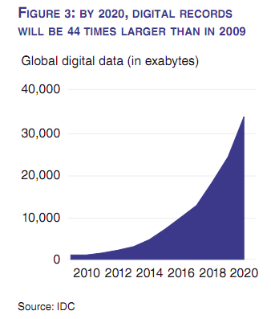
The moral of the story is…there is a splurge of data !
Data is getting accumulated at a breath taking speed.
Should touch 40,000 Exabytes by the year 2020.
As a result, the Big Data Industry is worth $100 Billion growing at 10% annually (Source – The Economist)
The volume exceeds the available storage, hence the need for the organizations to save the data wisely

Slide 15
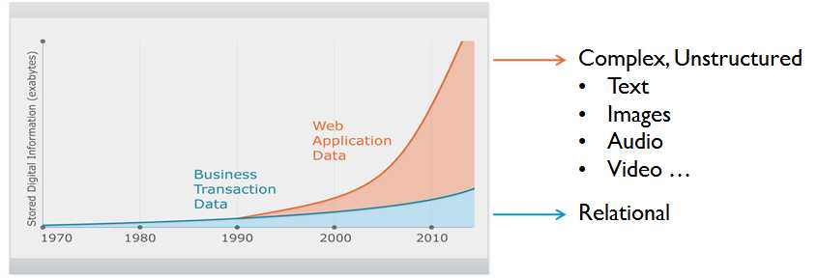
Big Data Industry Background – The reason !
TBD - Put Other examples here.
Till early nineties, the data generated by mainly structured.
From mid nineties onwards, there are had been a surge in unstructured data, mainly through social networking sites like Facebook, Twitter and linked in
We as individuals also generating a lot of data on frequent basis. Enterprise systems are also generating huge data critical to their business.

Slide 16
What is is Big Data ?
Big data is the term for a collection of data sets so large and complex that it becomes difficult to save & process it using on-hand database management tools or traditional data processing applications (Wikipedia)
IBM also described big data in terms of 3 parameters – Volume (e.g. Tweeter Data to check sentiments and show trends), Velocity (Analyze financial transactional Data to Detect Fraud Quickly) and Variety (Customer Satisfaction using data collected from multiple communication channels i.e. audio, video etc e.g. Tata Sky)

Slide 17
Limitation of Existing Solutions
Existing data solutions like RDBM cannot understand and save unstructured data very well.
Scaling RDBMS for a larger size of data turns out to be costly.

Slide 18


Hadoop comes to the rescue !
Hadoop understands unstructured data quite well.
It is also scales linearly in a cost effective manner.
Case Study
Sears Holding
Migrated from Mainframe, Tera Data and SAS based implementation to Hadoop. Brought down the analysis of their marketing campaigns from 6 weeks to weekly basis.
Reduced the over all cost of implementation too
Based on the success, they even launched a consulting organization of their own.
Sears Case Study

Slide 19
Hadoop comes to the rescue (Other Case Studies)
Net App creates storage systems to store, manage, protect and retain data for its customers (Customer’s System logs and diagnostics information)
It provides AutoSupport Platform to its customers to better monitor their stored data.
Customer used the AutoSupport platform in case on emergencies. NetApp use this platform for regular monitoring and health checks.
NetApp data grows at 7 TB per month.
Uses Cloudera Hadoop for its data storage and analytics purposes
Net App Case Study

Slide 20
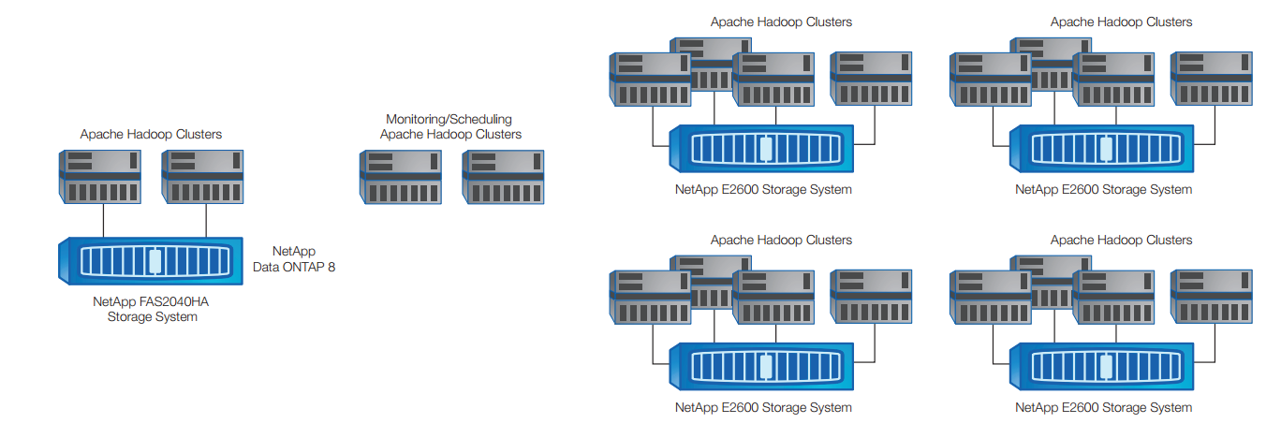
Hadoop comes to the rescue (Other Case Studies)

Slide 21
Hadoop comes to the rescue (Other Case Studies)
Link To Hadoop Case Studies
Other Case Studies

Slide 22

Hadoop Definition
Apache Hadoop is a framework that allows for the distributed processing of large data sets across clusters of commodity computers using a simple programming model.
It is an Open-source Data Management framework with scale-out storage & distributed processing capabilities.

Slide 23
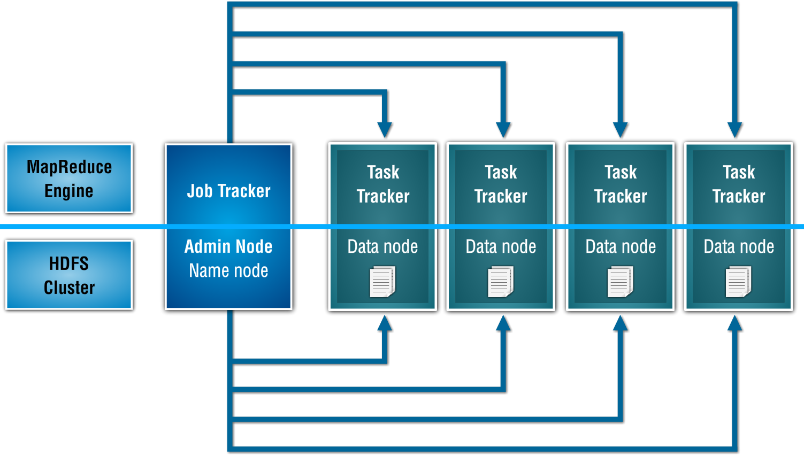
Hadoop Components (Daemons)

Slide 24
Bullet Points to undertand architecture
Blocks
This the smallest size in which Hadoop divides the big data files while saving it to the Hadoop Cluster
Mappers
Mapper are java programs confirming to Map Reduce Algorithm Standard. These programs run on each of the blocks of the big data file.
Reducers
Similar to mappers, reducers are also java program confirming to Map Reduce Algorithm Standard. They are aggregate functions which are supposed to run on the outputs of Mappers
Vertical Rack

Slide 25
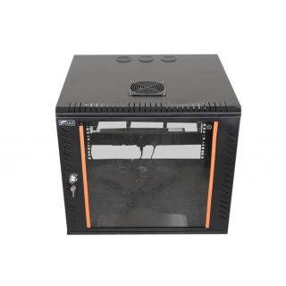

Additional Concepts - Computer Racks
A computer rack is a physical chassis that can house multiple computers or servers simultaneously. It is a mounting rack that has the ability to install more than one computer
Horizontal Rack
Vertical Rack

Slide 26
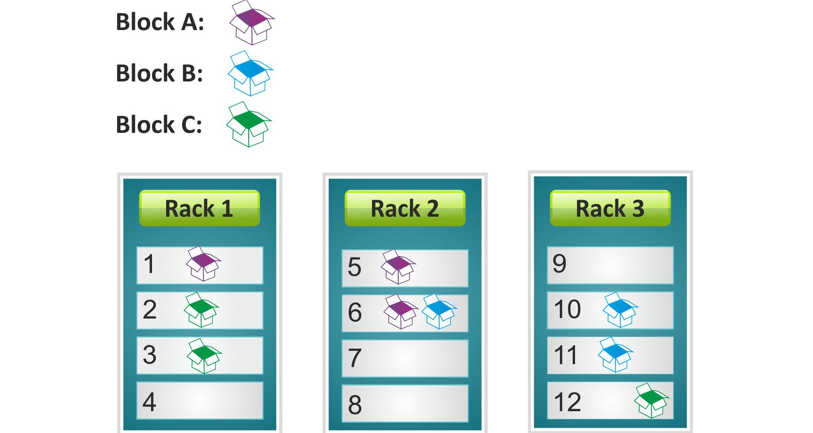
Additional Concepts - Rack Awareness
In Hadoop, blocks are saved in rack aware fashion

Slide 27
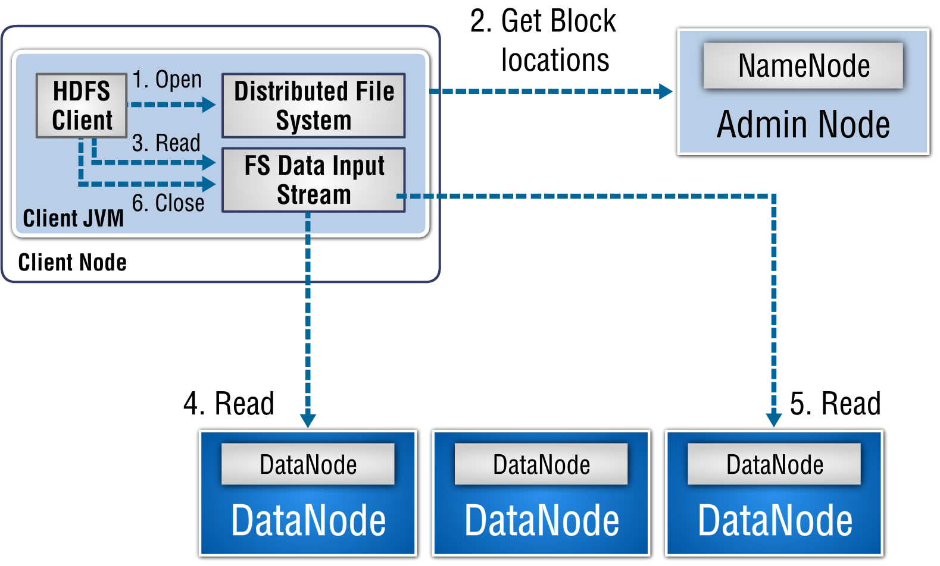
HDFS Architecture - Anatomy of File Read

Slide 28
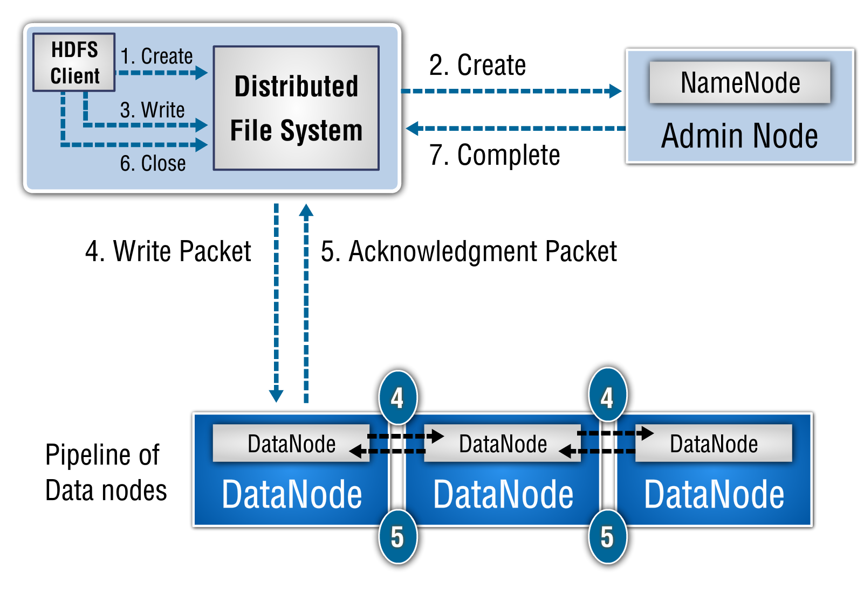
HDFS Architecture - Anatomy of File Write

Slide 29
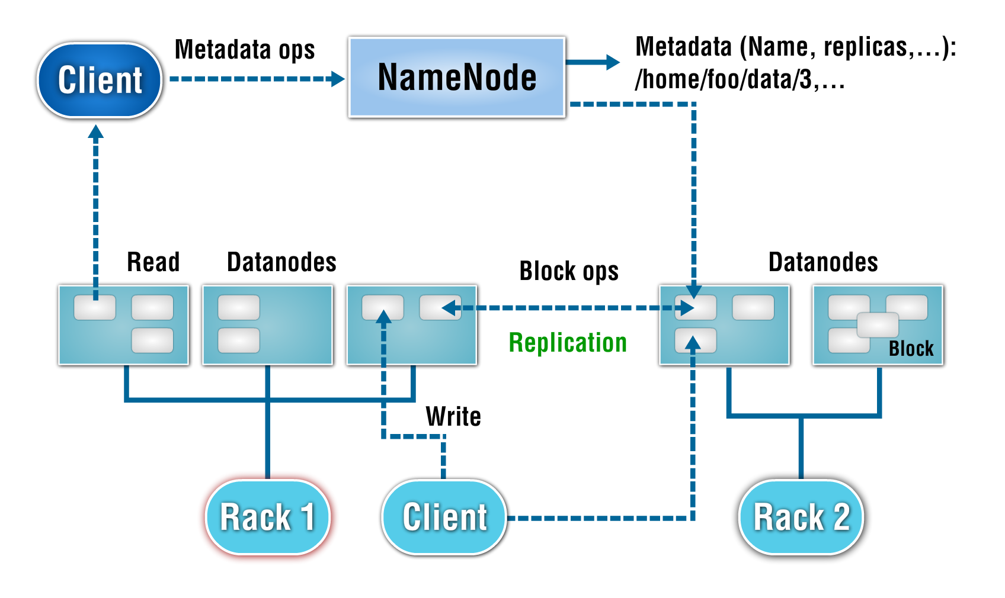
HDFS Architecture

Slide 30
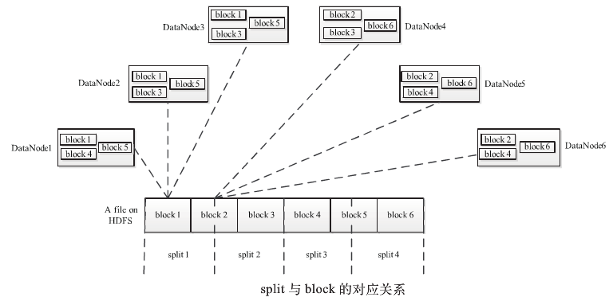
Block Versus Split
Block is a physical Division of data (Data at Write Time)
Split is a logical division of data (Data at Read Time)

Slide 31
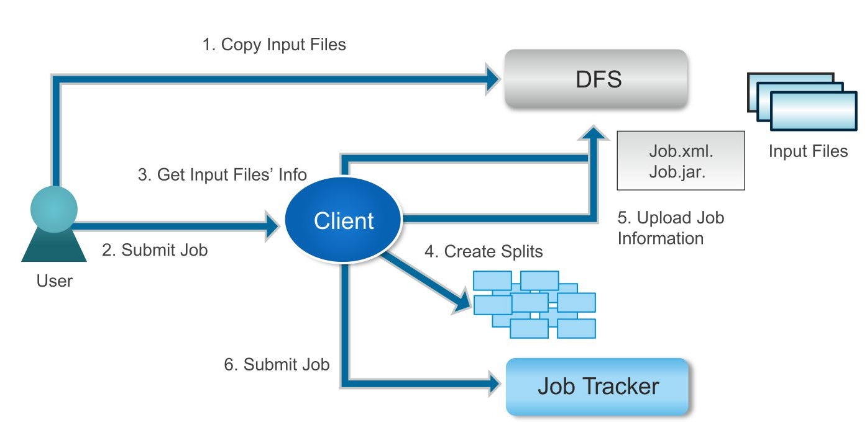
Map Reduce Process Flow – Job Submission

Slide 32
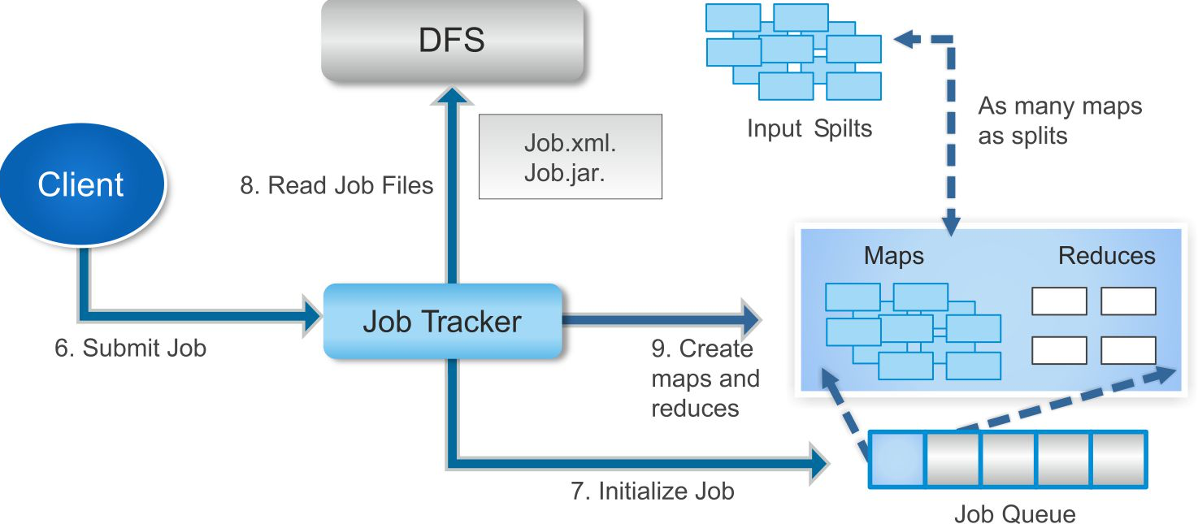
Map Reduce Process Flow (Job Initialization)

Slide 33
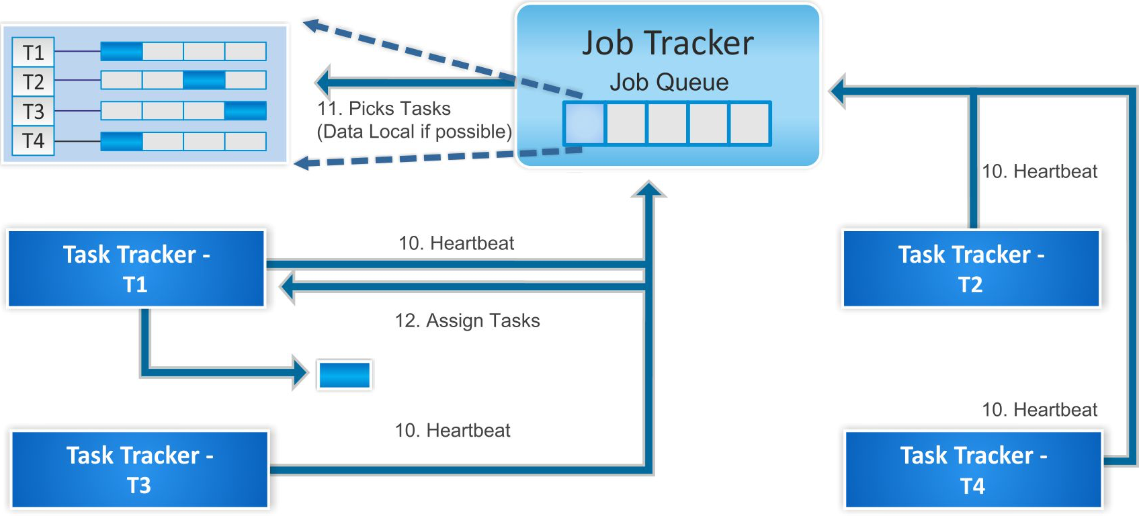
Map Reduce Process Flow (Task Assignment & Execution)

Slide 34

Queries

